Slide 1

Exploratory Data Analysis - EDA
Why do we need to perform EDA ?
The basic goal of exploratory data analysis is to obtain confidence on the data set to a point where we get ready to engage a machine learning algorithm on top of it.
Another benefit of EDA is to refine the selection of feature variables that will be used later for machine learning.
Steps taken as part of EDA :
NULL Check
Handling NULL values
Checking Duplicates
Treating duplicates
5 point summary of data sets
Graphical representation of datasets to better understand the data
Overview on data sets :
Datasets provided
Song Data – [ song_id, title, release, artist_name, year, artist_gender ]
Play Count Data – [ user_id, song_id, play_count ]
Additional Dtasets used
IMDB Rating Data – [ tconst, averageRating, numVotes ]
IMDB Movie Titles Data – [ titleId, ordering, title, region, language, types, attributes, isOriginalTitle ]
Musixmatch mxm_779k_matches Dataset – [ tid, artist name, title, mxm tid, artist_name, title.1 ]
Tagtraum msd_tagtraum_cd2c Dataset – [ track_id, genre ]

Slide 2
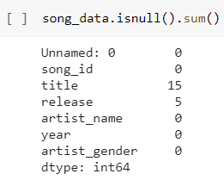
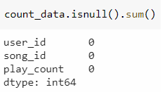
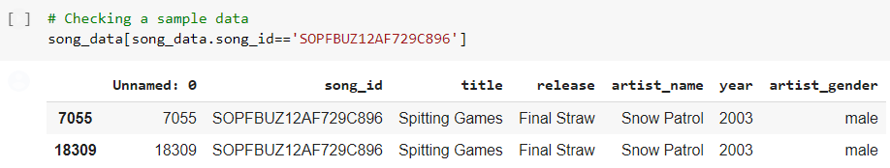


Logic – Exploratory Data Analysis
Step 1 : NULL Value Check. By applying the .info() method on the dataframes, we found that 15 titles & 5 releases are having NULL values in the Song Dataset. However, Play Count data has no null values.
Step 3 : Checking for duplicates. The Songs Dataset is having 498 duplicate records, but the Count data is not having any duplicated record.
Sample duplicate record :-
Step 4 : Treating duplicates. Dropping the duplicates from the Songs dataset with
inplace = True
Step 2 : Handling NULL values. Checking null values in song title and release has any impact
on play count data If there is no play count data available for the Null titles and releases then we can ignore them as they will not impact our analysis.
Confirmed by re-checking that duplicates does not exist in Sons data anymore.
value_counts provides a False output which means there is NO IMPACT as NULL titles do not have play counts. Hence, we han happily ignore both TITLES and RELEASES NULL values.

Slide 3
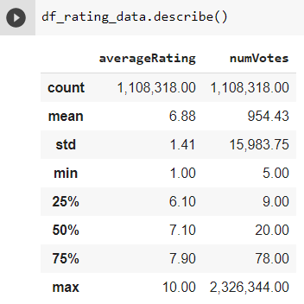
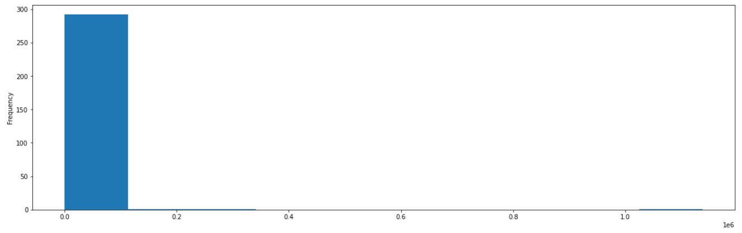
Logic – Exploratory Data Analysis
Step 5 : 5 point summary. We have applied the describe() operation to all the datasets to perform a more descriptive analysis on them.
All the datasets looked fine, except the IMDB Rating dataset, which seems to have a huge SKEW in one of the column numVotes.
Step 6 : Graphical visualization of datasets
The below snapshot of play count shows that the count is more in the lower rungs,
with an exception of a few in the higher rungs.

Slide 4
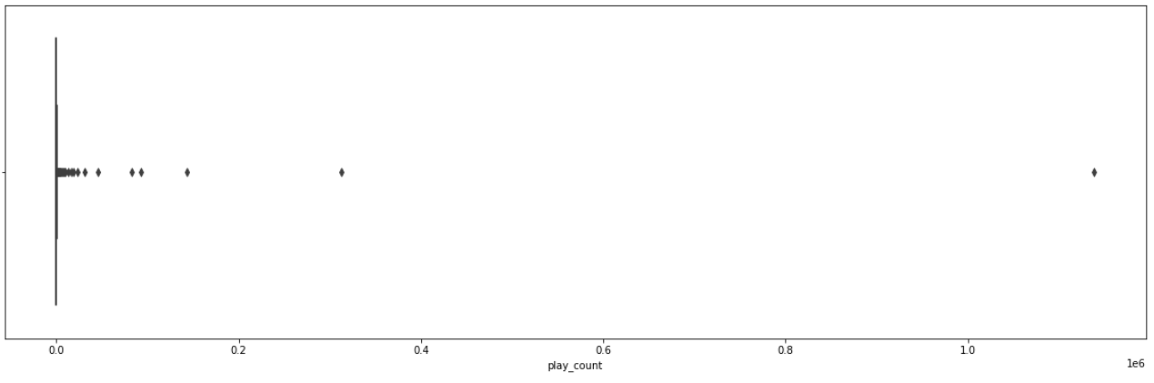
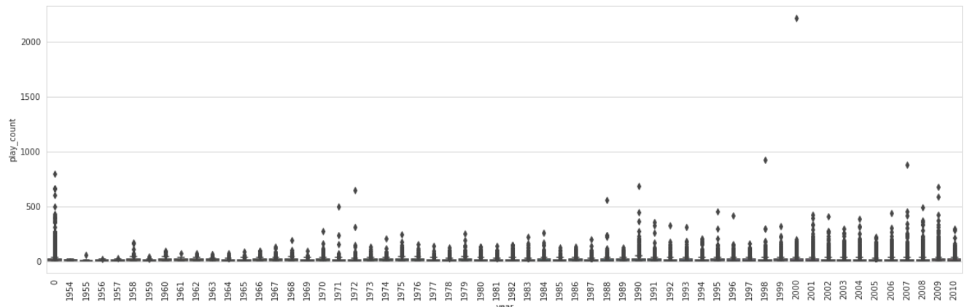
Logic – Exploratory Data Analysis
Validating the same using BoxPlot
We have merged the songs data with the play count data to analyze the evolution of the songs play count over the years & generated a box plot to visualize the data as shown below. It shows that the song play count has increased from the year 1990 onwards. This may be due to more availability of compact dics & improved internet connection over the years.

Slide 5
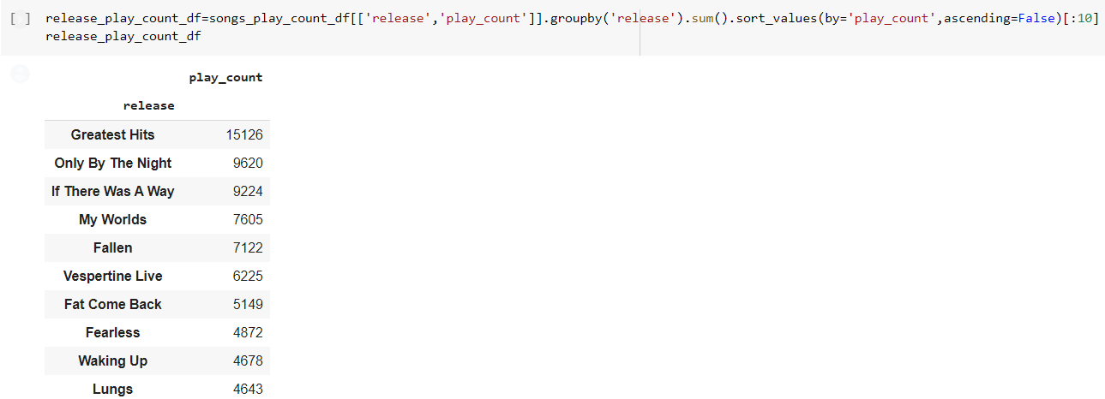
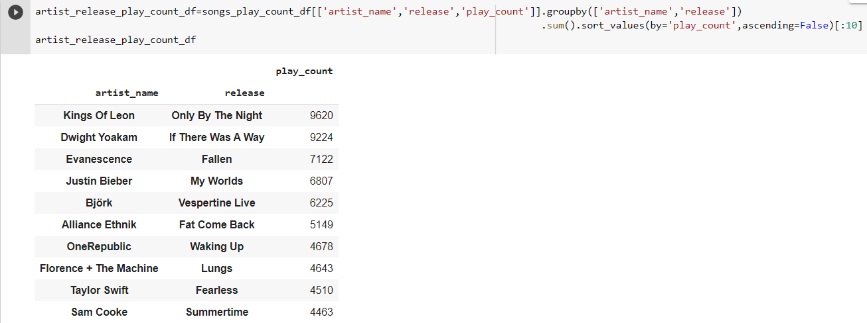
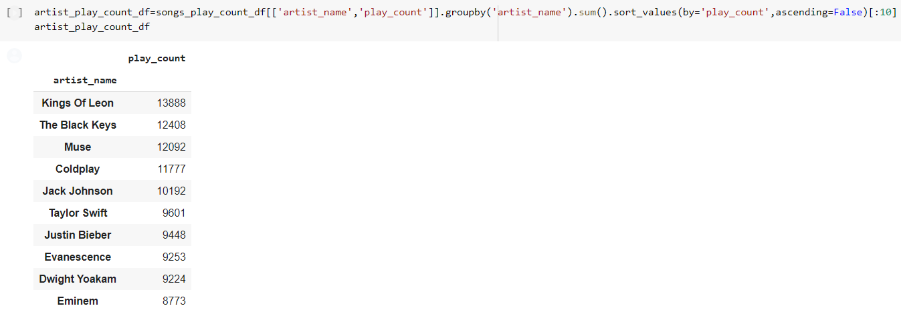
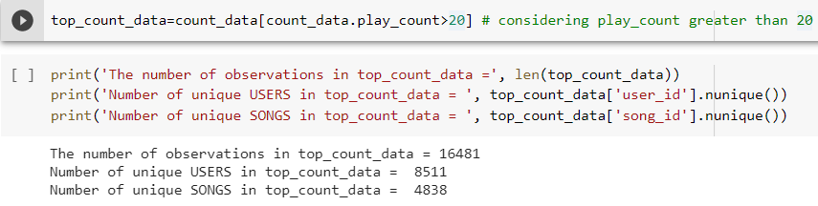
Logic – Exploratory Data Analysis
Few additional analysis on datasets based on specific columns.
Release wise sorted play count ( Top 10 )
Artist & release wise play count ( Top 10 )
Artist wise play count ( Top 10 )
Filtering songs data based on top play counts

Slide 6
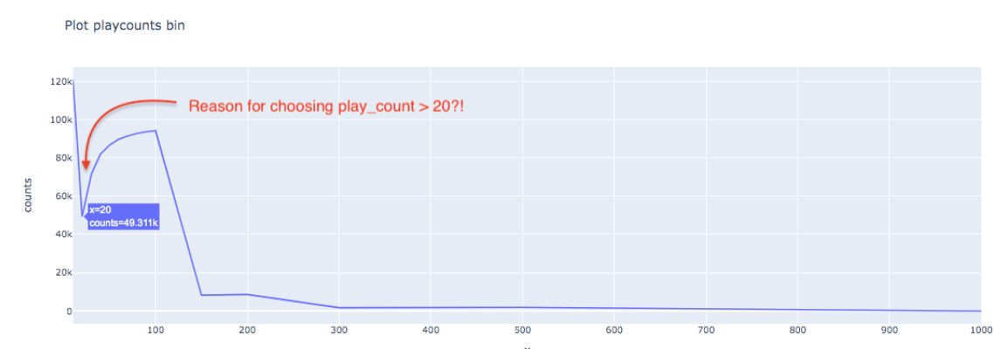
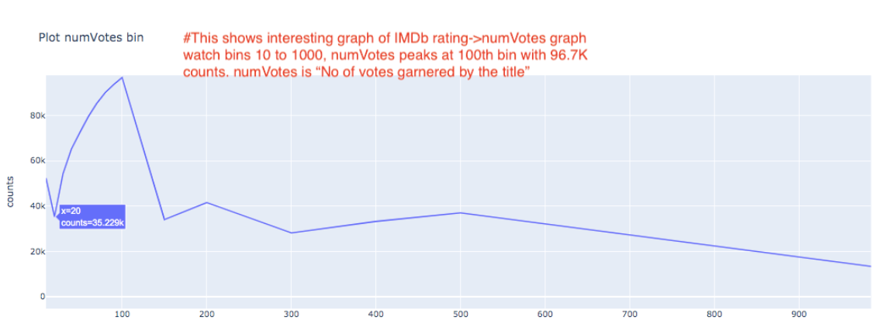
Logic – Exploratory Data Analysis
Why did we choose play_counts > 20 >

